Slide 1
Sequence Modeling
Vraj Suratwala
Department of ICT, VNSGU

Slide 2
Introduction to Sequence Modeling
Sequence modeling is a type of machine learning/deep learning approach used to process and learn from sequential or ordered data, where the order of elements is important.
Unlike ordinary data, the meaning of a current element may depend on previous or future elements in the sequence.
Examples:
  Text and sentences
  Speech signals
  Time-series data
  Stock-price sequences

Slide 3

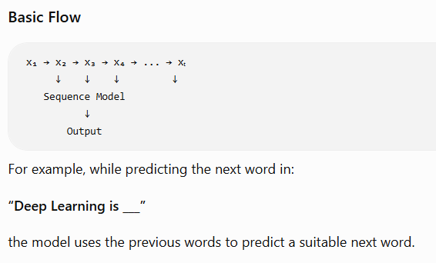
Basic Idea
A sequence can be represented as:
A sequence model processes the elements
step-by-step while learning relationships
between different time steps.

Slide 4
Why Sequence Modeling is Required?
Traditional neural networks generally treat inputs independently and do not naturally maintain information about previous inputs.
Sequence models are designed to capture:
  Temporal relationships
  Dependencies between elements
  Order of data
  Context from previous inputs
  Patterns that change over time

Slide 5
Types of Sequence Modeling
Common deep learning approaches for sequence modeling include:
Model Main Characteristic
RNN Maintains information from previous time steps
LSTM Handles long-term dependencies using memory mechanisms
GRU Simplified alternative to LSTM
Transformer Uses attention mechanisms to model relationships between sequence elements

Slide 6
5. Applications
Sequence modeling is widely used in:
Natural Language Processing (NLP) – language modeling, translation and text generation.
Speech Recognition – converting speech into text.
Time-Series Prediction – forecasting values over time.
Machine Translation – translating one language into another.
Video Analysis – understanding relationships between video frames.
Healthcare – analyzing patient measurements and medical time-series data.

Slide 7
RNN
Recurrent Nueral Network

Slide 8
What is RNN ?
A Recurrent Neural Network (RNN) is a type of neural network designed for sequence data, where the current output depends not only on the current input but also on information from previous time steps.
The key feature of an RNN is its recurrent connection, which allows it to maintain a form of memory of previous inputs.

Slide 9
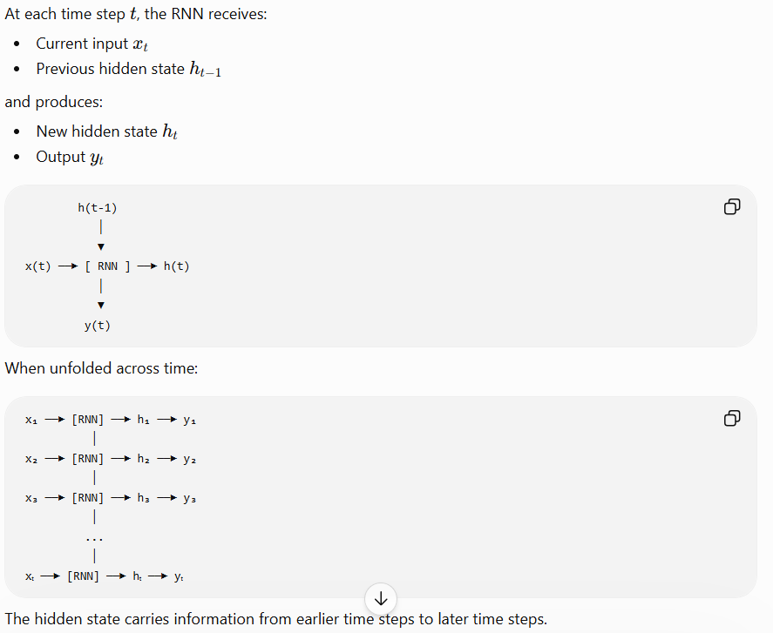
Basic Architecture

Slide 10
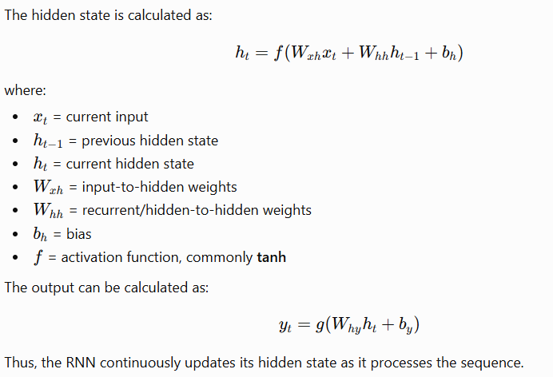
Working of RNN

Slide 11
Example
Consider the sentence:
“Deep learning is very powerful.”
The RNN processes the words sequentially:
Information from earlier words is carried through the hidden states, helping the network understand the context of later words.

Slide 12
Applications of RNN
RNNs are used for:
  Natural Language Processing (NLP)
  Language modeling
  Speech recognition
  Machine translation
  Time-series prediction
  Sentiment analysis
  Sequence classification

Slide 13
Pros & Cons
Advantages
  Suitable for sequential data.
  Maintains information from previous time steps.
  Can handle sequences of different lengths.
  Useful for time-dependent problems.
Limitation
  A basic RNN can suffer from the vanishing gradient problem, making it difficult to learn long-term dependencies. This led to improved architectures such as LSTM and GRU.

Slide 14
Architecture of RNN
https://www.geeksforgeeks.org/machine-learning/introduction-to-recurrent-neural-network/ - Refer this whole link.

Slide 15
Vanishing and Exploding Gradients
Vanishing gradient and exploding gradient are important problems that can occur while training deep neural networks, especially RNNs. They are related to how gradients behave during backpropagation through many layers or time steps.
1. Vanishing Gradient
  The vanishing gradient problem occurs when gradients become extremely small during backpropagation.
  As the gradient becomes smaller and smaller, the weights receive very small updates, making the network slow or unable to learn long-term dependencies.

Slide 16
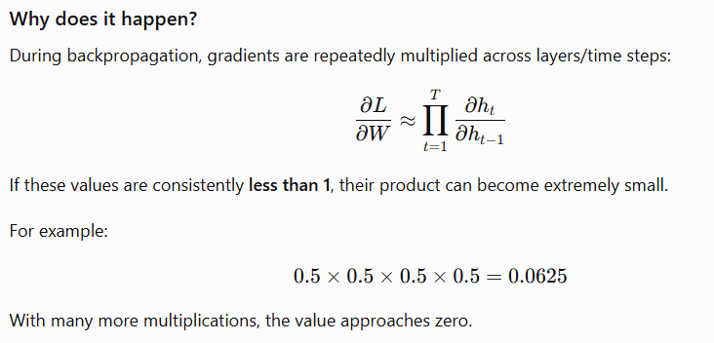
Effects
Very small weight updates.
Slow learning.
Difficulty learning long-term dependencies.
Earlier time steps in an RNN receive very little learning signal.
Can be particularly problematic with sigmoid and tanh activations in deep/recurrent networks.

Slide 17
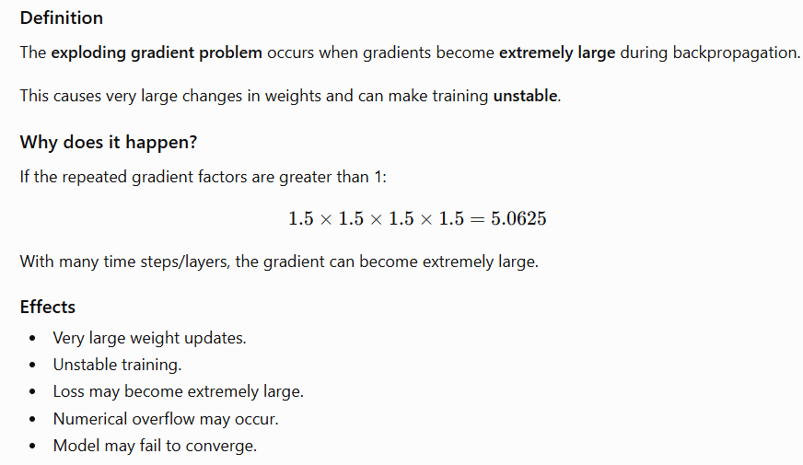
Exploding Gradient

Slide 18
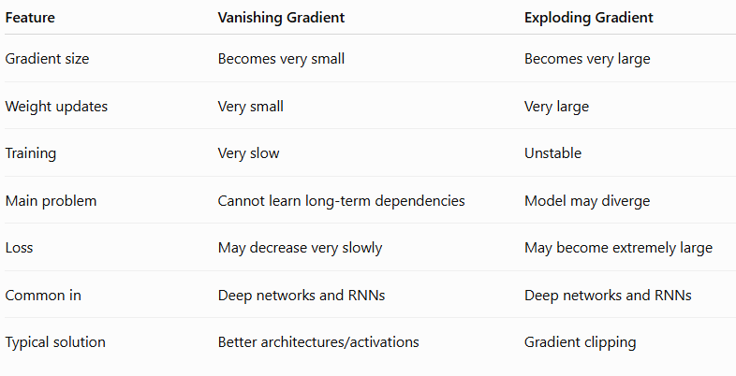
Vanishing vs Exploding Gradient

Slide 19
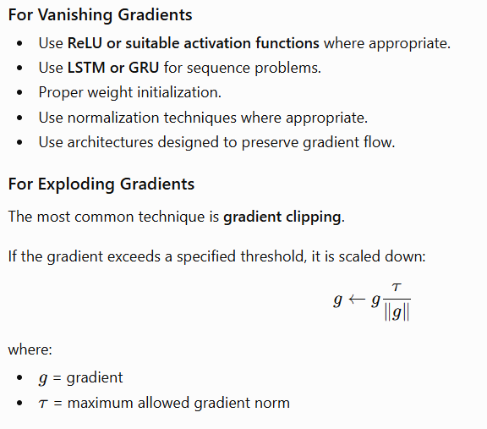
Solutions

Slide 20
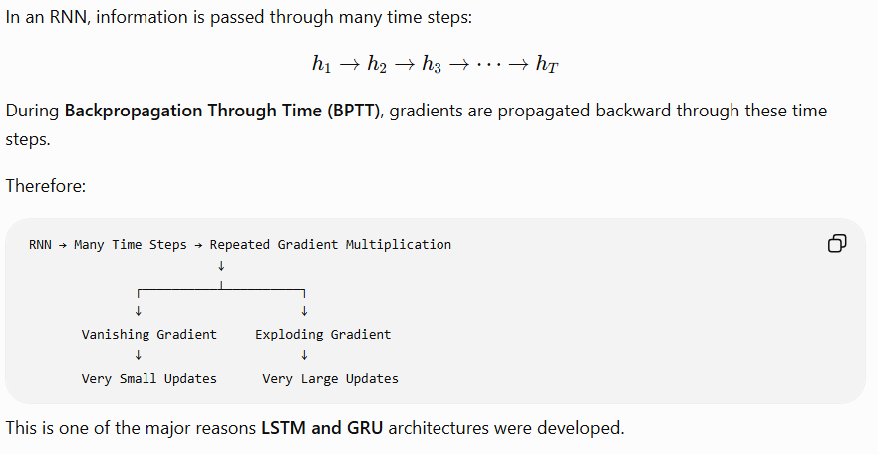
Relation to RNN

Slide 21
LSTM & It’s Application
Long Short-Term Memory (LSTM)

Slide 22
Introduction
Long Short-Term Memory (LSTM) is a special type of Recurrent Neural Network (RNN) designed to learn long-term dependencies in sequential data.
A basic RNN can suffer from the vanishing gradient problem, which makes it difficult to remember information from earlier time steps. LSTM addresses this problem using a memory cell and gates that control the flow of information.

Slide 23
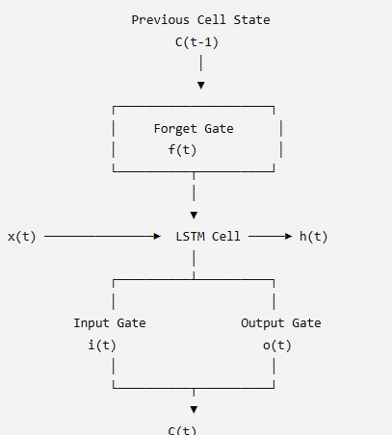
Basic Architecture of LSTM
An LSTM cell mainly consists of:
  Cell State (Ct) – stores long-term information.
  Hidden State (Ht) – carries the current output/state.
  Forget Gate – decides what information to remove.
  Input Gate – decides what new information to store.
  Output Gate – decides what information to output.

Slide 24
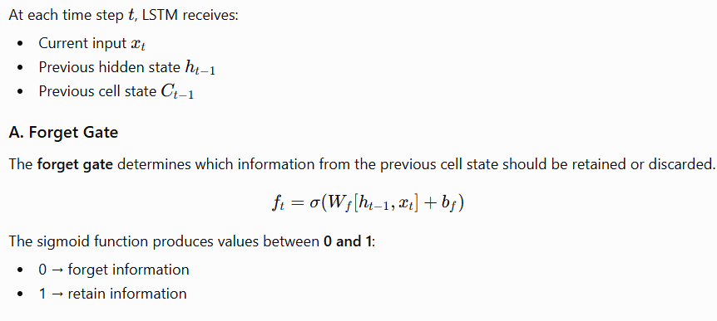
Working of LSTM

Slide 25
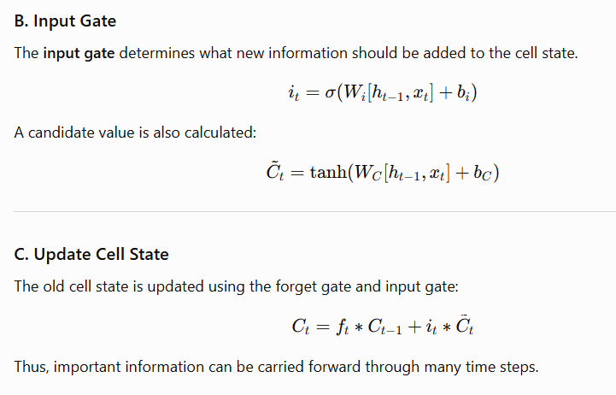
Working of LSTM

Slide 26
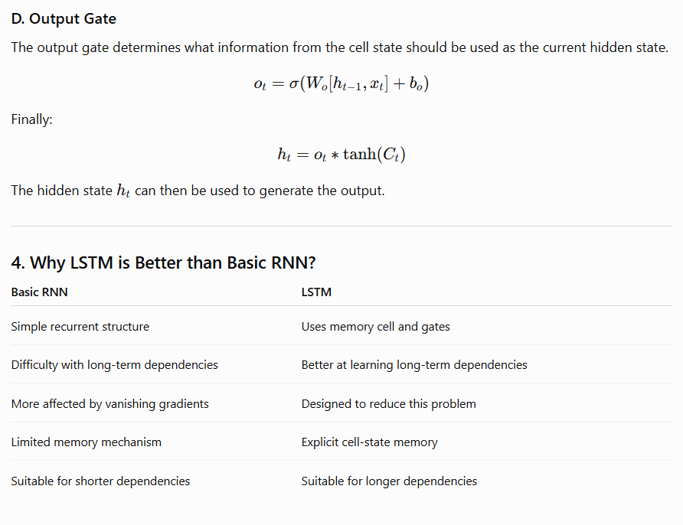

Slide 27
Applications of LSTM
1. Natural Language Processing
2. Speech Recognition
3. Machine Translation
4. Time-Series Forecasting
5. Healthcare
6. Video and Activity Analysis

Slide 28
Advantages of LSTM
Handles sequential data effectively.
Can learn long-term dependencies.
Better control of information flow through gates.
Reduces the effect of vanishing gradients compared with basic RNNs.
Useful for variable-length sequences.
Applicable to NLP, speech, healthcare, and time-series problems.

Slide 29
Introduction to LLM
Transformers, BERT and XLNet

Slide 30
Large Language Models (LLMs)
A Large Language Model (LLM) is a deep learning model trained on a very large amount of text data to understand and generate human language.
LLMs learn patterns between words, sentences, and larger sections of text. They can perform tasks such as:
  Text generation
  Question answering
  Text classification
  Language translation
  Summarization
  Sentiment analysis
  Information extraction
Modern LLMs are primarily based on the Transformer architecture.

Slide 31
Basic LLM Flow
Large Text Dataset
↓
Tokenization
↓
Transformer Model
↓
Language Understanding
↓
Prediction / Text Generation

Slide 32
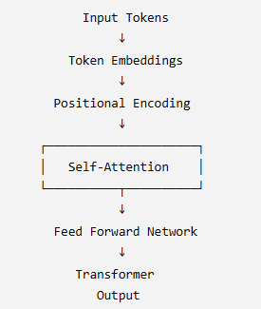
Transformers
A Transformer is a deep learning architecture introduced for processing sequential data using attention mechanisms, particularly self-attention.
Unlike traditional RNNs, Transformers can process many tokens in parallel and can effectively model relationships between words that are far apart in a sequence.

Slide 33
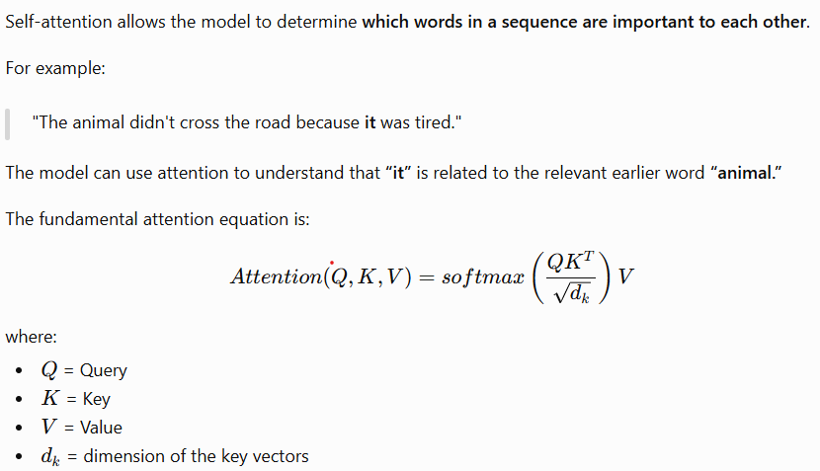
Self-Attention

Slide 34
Advantages of Transformers
Parallel processing of tokens.
Captures long-range dependencies.
More efficient than sequential RNN processing for many training tasks.
Forms the foundation of many modern language models.

Slide 35
BERT
BERT = Bidirectional Encoder Representations from Transformers
BERT is a Transformer-based language model developed for understanding natural language.
It uses the Transformer encoder architecture and processes context from both directions.
Example
The cat sat on the [MASK].
BERT can use the words before and after the masked position to predict the missing word.

Slide 36
Main Features of BERT
Bidirectional Context
  BERT considers information from both left and right sides of a word.
Transformer Encoder
  It uses Transformer encoder layers.
Pre-training and Fine-tuning
  BERT is first pretrained on large text datasets and can then be fine-tuned for specific tasks.
Masked Language Modeling (MLM)
  Some words are masked, and the model learns to predict them.

Slide 37
Applications
Text classification
Sentiment analysis
Question answering
Named Entity Recognition (NER)
Sentence classification
Search and information retrieval

Slide 38
XLNet
XLNet is a generalized autoregressive language model that uses Transformer-XL as its backbone and introduces permutation language modeling.
  It was developed to address some limitations of conventional language-model pre-training approaches.
Main Idea
  Instead of predicting words only from left to right, XLNet uses different permutations of the factorization order to learn from broader contextual information.

Slide 39
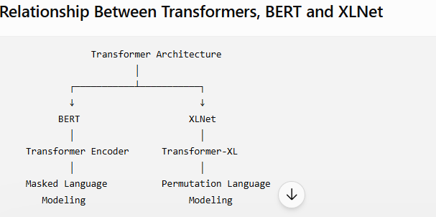
Example
Features of XLNet
Uses Transformer architecture.
Uses permutation language modeling.
Can capture bidirectional contextual information.
Builds on ideas from Transformer-XL.
Designed for strong language understanding.
Applications
Question answering
Text classification
Natural language understanding
Document analysis
Sentence classification
Normal left-to-right:
A → B → C → D
Permutation-based:
C → A → D → B

Slide 40
Thank you
Vraj Suratwala
Department of ICT, VNSGU

